Slide 1
Exploratory Analysis that Refined the Parameter of a Structure’s Year Built in Consumer Price Index Housing Age
Alice Yu,
Ayme Tomson, Ben Houck, & Chun Wing Tse
JSM 2024
08.05.2024 2PM
Disclaimer: This presentation provides a summary of research results. The information is
being released for statistical purposes, to inform interested parties, and to encourage
discussion of work in progress. The presentation does not represent an existing, or
forthcoming, new, official BLS statistical data product or production series.
Notes:
Good afternoon everyone, my name is Alice. Today I will be talking about [title] conducted by me, Ayme, Ben and Wing.
[read fine print on slide]

Slide 2
Overview
Background on CPI’s Housing Age-Bias Adjustment Factor
  Focus: Year-Built Value
  Issue: Previous Definition of “old”
Decision Architecture
  Domain-Driven Insights
  Data-Driven Methods
Conclusion
  Impact from new “old” definition

Slide 3
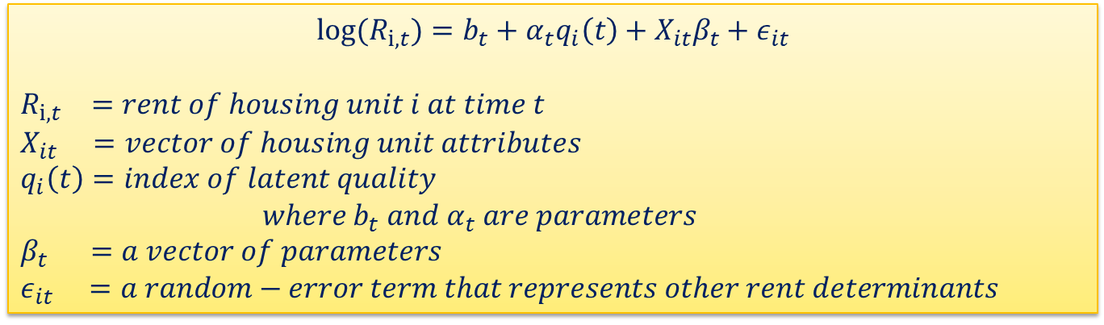
Background on CPI’s
Housing Age-Bias Adjustment Factor
Originated in 1988
  The hedonic regression model, used to estimate age-bias adjustment, serves as the basis for the process still in use today.
$${log⁡(R}_{i, t})=b_{t}+α_{t}q_{i}\left(t\right)+X_{it}β_{t}+ε_{it}$$
$$R_{i, t} =rent of housing unit i at time t$$
$$X_{it} =vector of housing unit attributes$$
$$q_{i}\left(t\right)=index of latent quality$$
$where{ b}_{t} and{ α}_{t} are parameters$
$$β_{t} =a vector of parameters$$
$ε_{it} =a random−error term that represents other rent determinants$
  Reference: Randolph, W.C. (1988, July) Housing Depreciation and Aging Bias in the Consumer Price Index. Journal of Business & Economics, Vol. 6, No.3, pp. 359-371
Notes:
Housing age-bias adjustment factor started in 1988 with William C. Randolph. He used hedonic regression methods to estimate average rental housing physical depreciation for areas of the United States and he estimated a downward quality bias of the CPI caused by rental-housing physical depreciation. This created a need to correct the shelter indexes and allow the physical depreciation of housing unit over time to be accounted for in quality adjustment. The hedonic regression model serves as the basis for the process still used today.
This is the hedonic regression we are talking about. (Click) It is also a logarithmic regression.
(Click) The housing unit attributes (X i,t) is the numerous measures of collected housing data (including structural characteristics, neighborhood, services included in the rent, and age of the dwelling) have changed over time. The first update was in 1999 to accommodate a new housing sample based on the 1990 census. This update entailed the addition of census data by zip code instead of census tract, to include units built after 1990. Many updates happens since, either to adapt to the changing market condition (like COVID) or to investigate characteristics variables that would improve the hedonic regression model.
(Click) The unmeasured attributes are represented here by an index of latent quality (qi(t)). And this is the part that’s associated with physical depreciation of a housing unit.

Slide 4
Current Hedonic Regression Model
log(rent) = f[17 structural characteristics variables, occupancy timeframe and income variables (bathrooms, bathrooms², bedrooms, bedrooms², other rooms, electric heat, gas heat, central air, window air, other air, detached, mobile home, senior com, elevator, new tenant, length of occupancy, adjusted average income),
Dummy variables (for all CPI pricing areas included within the census region or division),
9 neighborhood characteristics variables (density, age 65pl, large buildings, mobile homes, renter occ, school age, high poverty, age 3+college, age25+college
3 variables for services provided with rent (heat incl, electric incl, extra changes),
6 depreciation variables (age, age² age³, age_allrm, age_detach, ageold)]
+a random error term.
Notes:
Our current hedonic regression model looks like this.
It has 35 variables (excluding the dummy variables for location within a specific CPI pricing area).

Slide 5
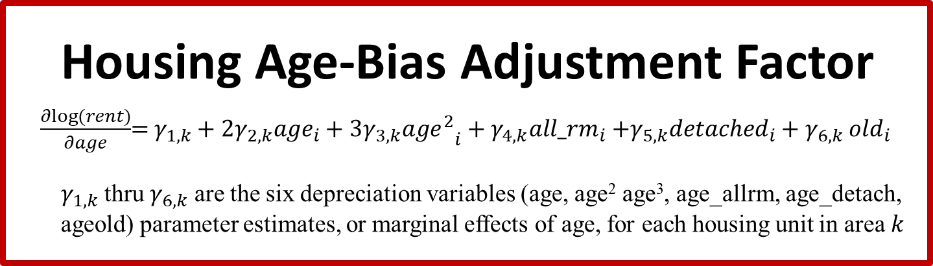
Current Hedonic Regression Model
  Housing Age-Bias Adjustment Factor
$\frac{∂log⁡(rent)}{∂age}$= $γ_{1,k}+2γ_{2,k}{age}_{i}+3γ_{3,k}{{age}^{2}}_{i}+γ_{4,k}{all_rm}_{i}{+γ_{5,k}{detached}_{i}+γ}_{6,k}{old}_{i}$
  $γ_{1,k}$ thru $γ_{6,k}$ are the six depreciation variables (age, age² age³, age_allrm, age_detach, ageold) parameter estimates, or marginal effects of age, for each housing unit in area $k$
log(rent) = f[17 structural characteristics variables, occupancy timeframe and income variables (bathrooms, bathrooms², bedrooms, bedrooms², other rooms, electric heat, gas heat, central air, window air, other air, detached, mobile home, senior com, elevator, new tenant, length of occupancy, adjusted average income),
Dummy variables (for all CPI pricing areas included within the census region or division),
9 neighborhood characteristics variables (density, age 65pl, large buildings, mobile homes, renter occ, school age, high poverty, age 3+college, age25+college
3 variables for services provided with rent (heat incl, electric incl, extra changes),
6 depreciation variables (age, age², age³, age_allrm, age_detach, ageold)]
+a random error term.
  ageold = age X old
  where:
  age= current year – the housing unit’s year-built value
  old = (previously)
  1: if age of structure built is between 1900 and 1919,
  0: otherwise
Focus
Focus
Notes:
Our focus today is mainly on the 6 depreciation variables and more specifically on “ageold” variable.
age_allrm= age time the total number of rooms
age_detach= age for single, detached structures (0 otherwise)
Old is a binary variable. (Previous definition shown above, read out equation above)
We are just focusing on the depreciation variables because (Click) the age-bias adjustment factor is the partial derivative of the logarithm of rent with respect to age as (you can see from the equation on the slide, read out equation above)
SO… now that we know where the ‘ageold’ is in the BLS model and ‘old’ variable is in the housing age-bias adjustment factor, let’s get to the issue that jump started our research.

Slide 6
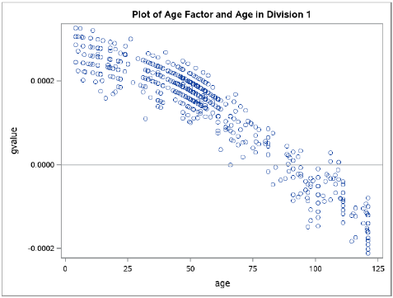
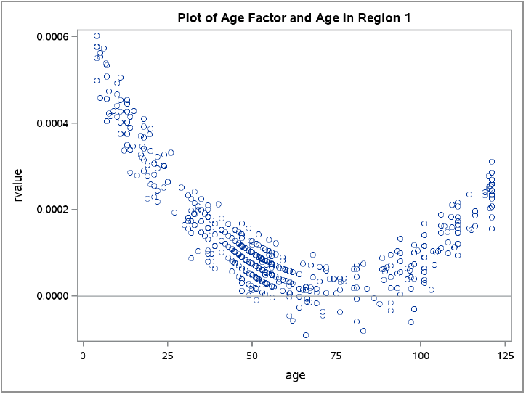
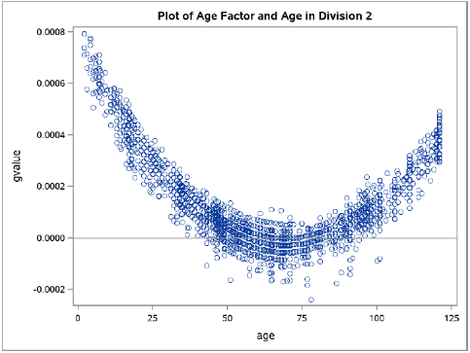
Background on CPI’s
Housing Age-Bias Adjustment Factor
Issue with Previous Definition of “old”
  Timeline: 1988 – “old” referred to housing unit built before 1900
  <2007 – “old” referred to housing units aged 100 or older
  Results with Previous Definition of “old”:
Notes:
In 1988 when age bias was first introduced, “old” referred to housing unit built before 1900. Since 2007 or longer, “old” was referred to housing units aged 100 and older, and by 2020, the definition remains. It has been a long time since this variable has been reviewed and maintained.
(Click) Here are graphs that shows the age-bias adjustment factors with respective to age for each housing unit in that census region 1 and census division 1 & 2.
(Point out: 0 line (Click), y-axis=Age Factor, x-axis=Age (or current year minus a housing unit’s Year Built value)
Now that we know how to understand these charts, let’s just look at all of the census regions and divisions at once.

Slide 7

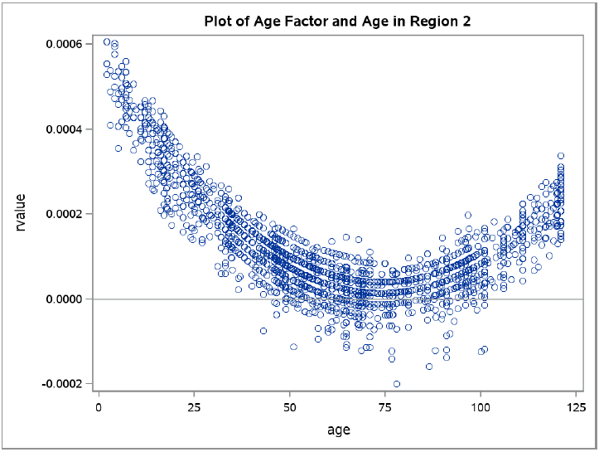
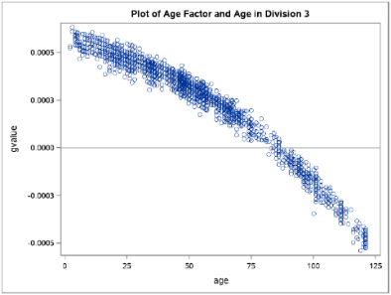

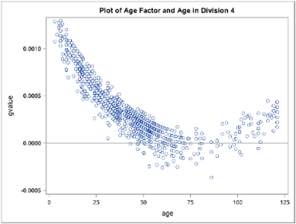
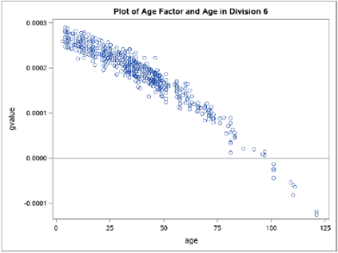
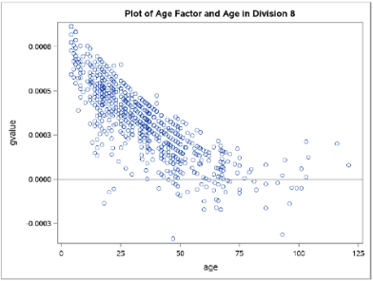
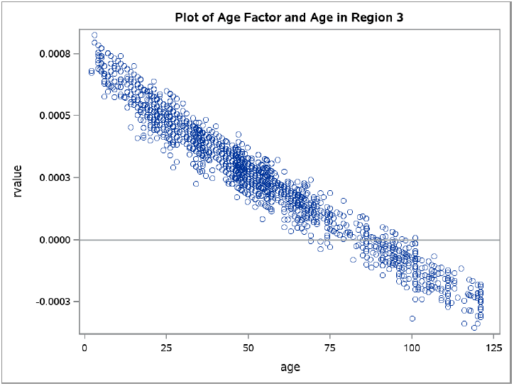
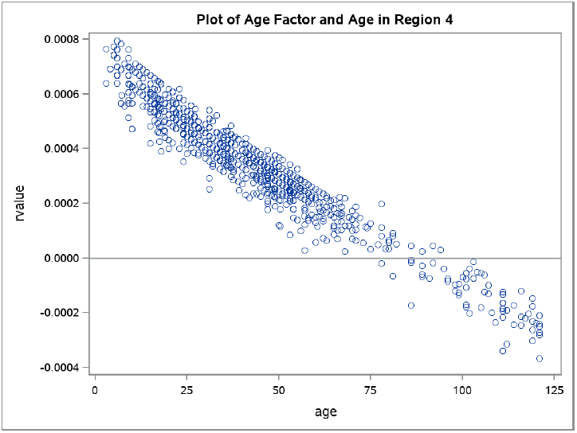
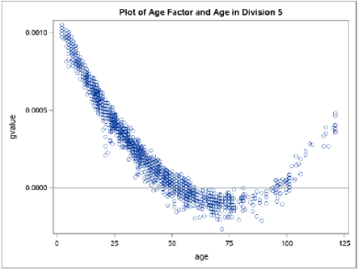
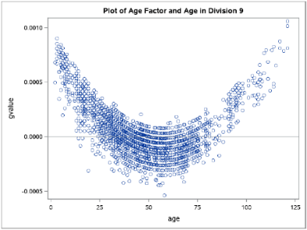
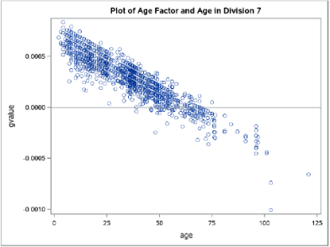
Region 1: Northeast
Region 2: Midwest
Region 3 : South
Region 4: West
Notes:
Again, the graphs shows the age-bias adjustment factors with respective to age for each housing unit in that census region or census division. Issues with old housing units can be observed. All charts show housing units at one point in the negative value. This should not happen, but one possible reason is due to major renovation in the housing unit. Some charts also appear to have a U-shaped trend, which indicates a possible understatement on depreciation effect on newer housing unit over time and an overstatement of rent reducing effect of age for older units. Removing older housing units could improve the fit of the BLS model.
This moved us forward to update the ‘old’ variable definition to a new threshold.

Slide 8
Overview
Background on CPI’s Housing Age-Bias Adjustment Factor
  Focus: Year-Built Value
  Issue: Previous Definition of “old”
Decision Architecture
  Domain-Driven Insights
  Data-Driven Methods
Conclusion
  Impact from new “old” definition

Slide 9
Decision Architecture
Start:‘old’ = Static 1919 Threshold
Static or Dynamic
Domain vs Data
Global vs Units
Threshold Type
Scope
Motivation
Notes:
The existing “ageold” variable used in the age-bias adjustment factor is based on a static threshold, derived from the “old” variable, but this approach lacks robust justification. To improve the motivation behind the “ageold” variable, it is crucial to re-examine the threshold year that defines “old”. This investigation should explore several factors: whether the threshold should be static (a fixed year cutoff) or dynamic (a duration of year cutoff based on the sample selection year), the balance between domain-driven insights versus purely data-driven methods for setting the threshold year, and the CPI pricing area (PSU) scope to which the threshold should apply. A more accurate and contextually relevant “ageold” variable can help achieve better age-bias adjustment across diverse geographical units.

Slide 10
Decision Architecture
Static or Dynamic
Domain vs Data
Global vs Units
Domain-Driven Insights
  Accurate Year-Built value is important!
  Concerns
    overrepresenting depreciation of ‘old’ housing since major improvement to housing units are not considered
    permit(s) required projects doesn’t change the Year-Built value, or reflected in age bias
Notes:
The accuracy of the “year built” variable is important. CPI Housing methodology has used the “year built” variable to engineer 6 “depreciation” variables. Recent improvements in the efforts used to obtain ‘Year built’ data include data collectors using tax assessment data and other resources. One concern with the accuracy of the “year built” data is overrepresenting depreciation of old housing units since major improvement to the housing unit are not considered. Major improvements, such as permit(s)-required projects would not change the ‘Year built’ data, and therefore not reflected in age bias. Only addition or removal of bathroom, bedroom, and other room are reflected in structural change factors.
(Once again) The previous definition of ‘old’ are units with a “year built” in 1919 or earlier. (So) Major home improvement work from 1920 - present has been analyzed for key factors that influence property value.

Slide 11
Decision Architecture
Static or Dynamic
Domain vs Data
Global vs Units
Domain-Driven Insights
  Some general permit required projects:
    Plumbing: Around 1950, the first PVC pipes were laid in the US which provided an alternative and more affordable plumbing improvement work
    Electrical: In 1913, Fred W. Wolf invented the first home electric refrigerator. By 1940s, having a compressor refrigerator became the standard for almost all home kitchens
    HVAC: By 1960s, most new homes had central air conditioning. Window air conditioners were more affordable than ever, fueling population growth in the hot weather states.
Notes:
(freestyle from reading the slide)

Slide 12
Decision Architecture
Static or Dynamic
Domain vs Data
Global vs Units
Domain-Driven Insights
  Some non-permit projects not reflected in the model:
    Windows: Double-pane windows are the most widely used, but they weren’t widely available to residential homes until the 1970s
    Painting: In 1978, lead paint in homes were banned
  A requirement for a property to be official listed in the National Register of Historic Places is the property must be more than fifty years old.
Notes:
(freestyle from reading the slide)
CLICK: (Other thing to note for domain-driven insight is) The U.S. Department of the Interior’s National Park Service have the National Register of Historic Places. This is the official list of the Nation’s historic places worthy of preservation. There are many requirements for a property to be considered and one of the requirements is the property must be more than fifty years old. This fifty-years standard was established by National Park Service historians in 1948.^{[6]}

Slide 13
Decision Architecture
Static or Dynamic
Domain vs Data
Global vs Units
Data-Driven Methods
  Testing Data
    From:
    CPI Housing Survey Collection
    Census Data ->
    ACS 5-year at the block group level
    Income Data ->
    IRS published statistics
  Exploratory Analysis
    Coding/Modeling:
    Language: Python
      Python Packages:
      pandas
      statsmodels.api
    Years:
    Primary Data: 2022
    Secondary Data: 2014
Notes:
(Let’s now move on to data-driven methods)
Most of the input data are derived directly from the CPI Housing Survey collection. Census data are from the American Community Survey (ACS) 5-year data at the block group level. Income data are from the IRS’s most recently published statistics and include the total adjusted gross income and number of returns by zip-code level [9]. The primary data used is 2022 data. The secondary data used to confirm initial findings is 2014 data.
The primary (2022) and the secondary (2014) data can be divided into smaller geographical units based on 4 Census Regions, 9 Divisions, and 75 (for 2022)/87 (for 2014) primary sampling units (PSUs). While the number of geographical units is consistent across the primary and secondary data, there are variations in how the units are defined due to changes in methodologies over time.
(CLICK) The data-driven exploration uses Python code and regression analysis of existing CPI Housing Age Bias SAS code regression analysis. The Python packages used were:
Pandas: to import the data (the datasets were clean without any missing values. The only challenge was improper labels.)
and
statsmodel.api: for regression analysis (generating information such as p-values that I’ll show you in the next 3 slides.)

Slide 14
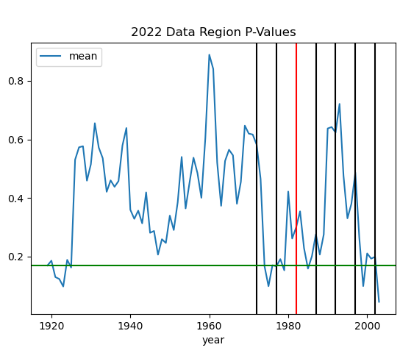
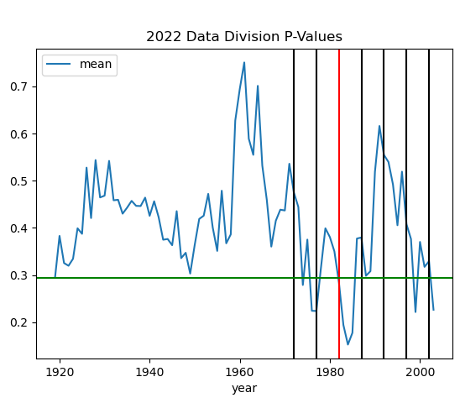
Decision Architecture
Static or Dynamic
Domain vs Data
Global vs Units
Data-Driven Methods
  Exploratory Analysis
    Primary (2022) Data
Figure 1: 2022 Averaged p-value for Regions
Figure 2: 2022 Averaged p-value for Divisions
Notes:
For the primary (2022) data, we ran the regressions for all four regions and nine divisions to obtain the p-values for “ageold” variable. The data sample distributions can be seen in Figure 1 (Region) and Figure 2 (Division). For each given threshold year, we examine 4 region and 9 division p-values for the “ageold” variable. Using the p-value results, we perform descriptive statistics and explore the differences in p-value changes across time and geographic units. Our Agile, iterative project methodology allowed us to use gathered domain knowledge to further narrow the years of interest to be windows from the year-of-data of (CLICK) 50, (CLICK) 45, (CLICK) 40, (CLICK) 35, (CLICK) 30, (CLICK) 25, and (CLICK) 20 (vertical line on the far right) years past (e.g. a 50-year window for the 2022 data would create a threshold at the year 1972) – the vertical lines on Figures 1 and 2. The horizontal line is the baseline p-value for comparison (with previous definition of old).
(Freestyle (CLICK) to remove the year window(s) that doesn’t look too good from the given charts)

Slide 15
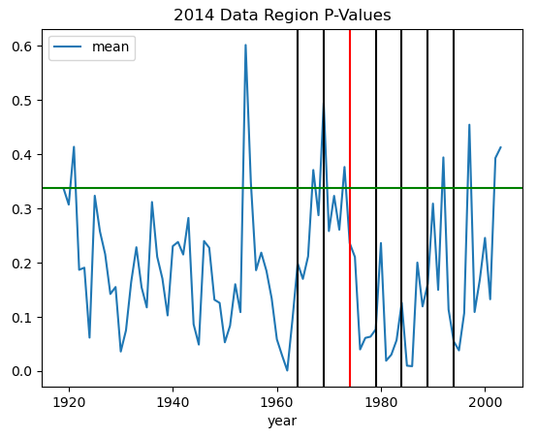
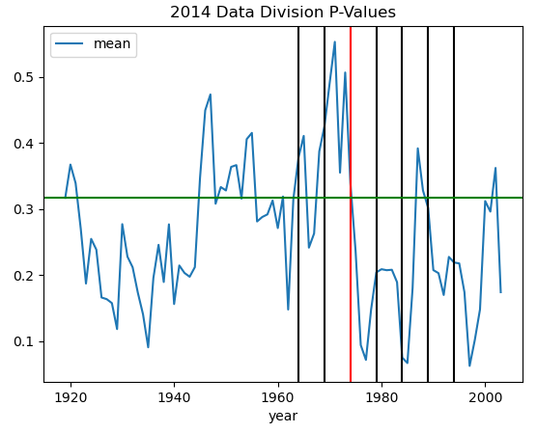
Decision Architecture
Static or Dynamic
Domain vs Data
Global vs Units
Data-Driven Methods
  Exploratory Analysis
    Secondary (2014) Data
Figure 3: 2014 Averaged p-value for Regions
Figure 4: 2014 Averaged p-value for Divisions
Notes:
To see if we have similar results with a different dataset, we use the 2014 data and ran the same regressions as we did in the 2022 data. Again, we used every year between 1919 and 2014 as the threshold year and ran regressions for every region and division. Then we could get the change in p-values across cut-off years for every region and division with 2014 data. One challenge is that the geographical classification is different in the 2014 data than that of the 2022 data. Hence, the regression specifications used different sets of geographical dummies (PSU dummies) from those for 2022 data. We used our previously narrowed windowed approach to get descriptive statistics and p-value difference comparisons for the threshold years of interest (years of interest to be windows from the year-of-data of (CLICK) 50, (CLICK) 45, (CLICK) 40, (CLICK) 35, (CLICK) 30, (CLICK) 25, and (CLICK) 20 years past ). Figures 3 and 4 show the specific years of interest with vertical lines and a horizontal line for the comparison p-value from 1919.
(Freestyle (CLICK) to remove the year window(s) that doesn’t look too good from the given charts)

Slide 16
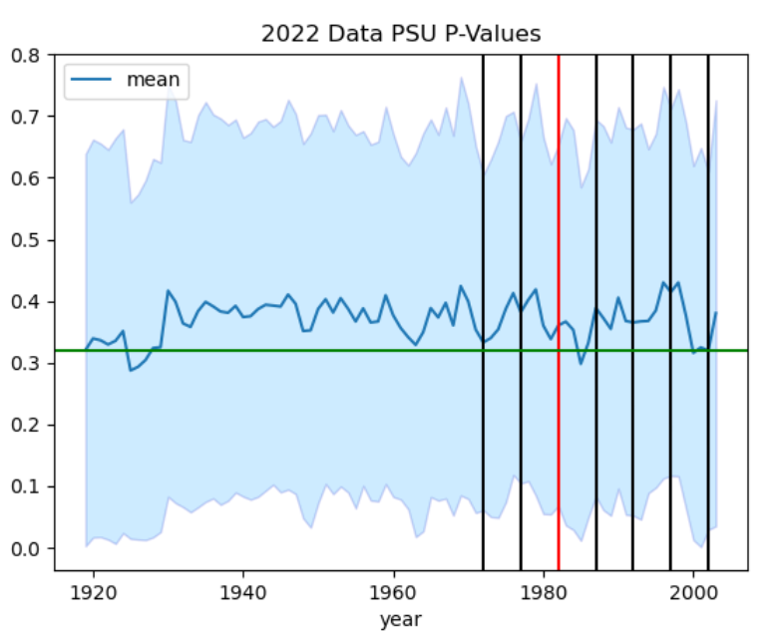
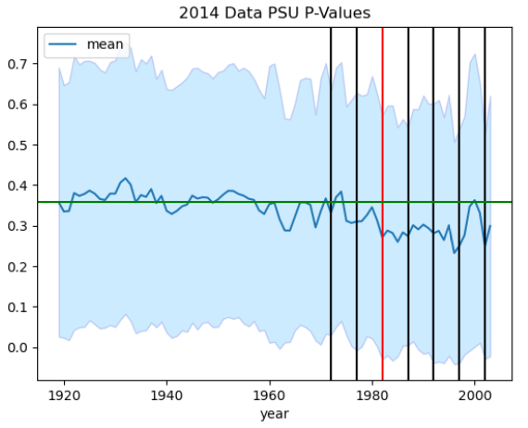
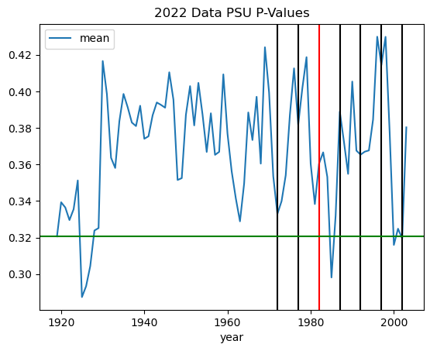
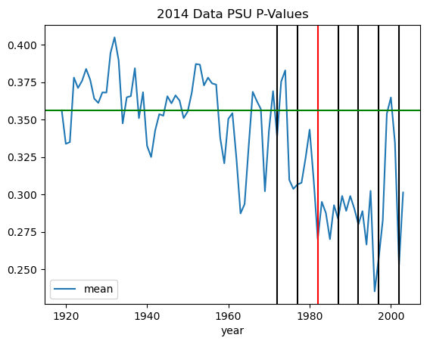
Decision Architecture
Static or Dynamic
Domain vs Data
Global vs Units
Data-Driven Methods
  Exploratory Analysis
    CPI Pricing Area (PSU) Scope
Figure 5: 2022 Averaged p-value by PSUs
Figure 6: 2014 Averaged p-value by PSUs
Notes:
To confirm our primary and secondary results, we further separated the primary (2022) and secondary data by PSU. This provided a final level of analysis at the narrowest geographic scope (PSU). Again, for our analysis, we used every year between 1919 and 2014 as the threshold year. We went down to the PSU level and ran regressions for each PSU. For the primary 2022 data, we ran 75 models (one for each PSU) for each year of interest. For the secondary 2014 data, we were able to run 87 models for PSU’s with at least 30 observations. Unlike regressions for regions and divisions, PSU dummies cannot be included in the regressions. We then performed the same descriptive analyses and difference comparisons as for the region and division geographic levels. Figures 5 and 6 show the average p-values across time for the 75- 2022 PSU and 87- 2014 PSU models, respectively.
(Freestyle about years window: (CLICK) 50, (CLICK) 45, (CLICK) 40, (CLICK) 35, (CLICK) 30, (CLICK) 25, and (CLICK) 20)
(Freestyle (CLICK) to remove the year window(s) that doesn’t look too good from primary and secondary data)
Note: Light Blue is the standard deviation area.

Slide 17
Overview
Background on CPI’s Housing Age-Bias Adjustment Factor
  Focus: Year-Built Value
  Issue: Previous Definition of “old”
Decision Architecture
  Domain-Driven Insights
  Data-Driven Methods
Conclusion
  Impact from new “old” definition

Slide 18
Conclusion
Dynamic threshold would remove older units that we have very few data on already
Domain-Driven Insights:
  Units built at or close to 1978 threshold
  Dynamic threshold is favored
Data-Driven Methods:
  Dynamic threshold years of interest: 40, 35, & 20
  old = (updated definition)
  1: if age of structure built within 40-years,
  0: otherwise
Notes:
Previously, the "old" housing unit was not very well defined, and the modeling results proved that the variable ageold was often not statistically significant. The previous definition was anything built between 1900 and 1919. But each passing year we were getting fewer and fewer of these units, and the definition was static. A dynamic threshold would change with each year that we process data, and one that was proven to be a statistically better definition than what we had.
(CLICK) From domain driven insights, ‘old’ is recommended to be re-defined with a cut off for units built at or before 1978. This would eliminate all the units that may have used ‘old’ home improvement criteria such, as lead paint. Also, to keep the new definition up to date in the future, it is recommended to use the National Park Service’s method with length of year definition, versus a particular year definition.
(CLICK) With the addition of the data-driven results, we further narrowed our years of interest to the 40, 35, and 20 year windows.
With the combined domain-driven insights and data-driven methods, (CLICK) a 40-year dynamic threshold window for the “old” variable was determined to be the best suitable replacement of the current static 1919 threshold. This new definition would at minimum be a better fit to our BLS model compared to the previous definition of “ageold” that haven’t been updated in awhile.

Slide 19
Conclusion
Impact from new ‘old’ definition
Notes:
This graph shows the housing age-bias adjustment factor using 2023 data. There are 75 PSUs (primary sampling units) in the x-axis. The darker line was created using the previous ‘old’ definition with 1919 threshold and the lighter line was created using the current ‘old’ definition with 40-year window threshold. As you can see, the 2 lines doesn’t have that much differences so this change wouldn’t create that big of an impact, but we have overall, updated a variable that was out of date and needed revision!

Slide 20
Alice Yu
Mathematical Statistician
Survey Research & Analysis Branch
Price Statistical Methods Division
Office of Prices and Living Conditions
Yu.Alice@bls.gov
Ayme Tomson
Data Scientist
System Procedures R&V Section
Consumer Prices & Price Indexes Division
Office of Prices and Living Conditions
Tomson.Ayme@bls.gov
Ben Houck
Economist
Housing Section
Consumer Prices Branch
Office of Prices and Living Conditions
Houck.Ben@bls.gov
Chun Wing Tse
Data Scientist
Process Management Section
Industrial Prices & Prices Indexes Division
Office of Prices and Living Conditions
Tse.ChunWing@bls.gov

